Slide 1
Discovering Suspicious File Migration With AWS Cloud
Name: Kesavan PR, Kiruba Shankar AP.
Register-NO: 312319104072, 312319104075
Project Guide: Dr.Pandeeswaran.

Slide 2
CONTENT:
S.NO | CONTENT | PAGE NO.
1 | Objective | 3
2 | Problem Statement | 4
3 | Abstract | 5
4 | System Requirements | 6
5 | Existing System | 8
6 | Literature Survey | 9
7 | Proposed System | 15
8 | Advantages | 16
9 | Architecture Diagram | 17
10 | DFDs | 21
11 | Modules | 26
12 | Design Diagram | 32
13 | Screenshots | 39
14 | Conclusion | 40
15 | Future Enhancement | 41
16 | References | ⁴²

Slide 3
Objective:
1.)To Secure File From Suspicious Migration.
2.)To Implement AES Algorithm to Enhance Security Method.
3.)To Provide RDS Cloud From AWS , Secure Database and Used For Storage.

Slide 4
PROBLEM STATEMENT:
Our Problem is to investigate how an organization can control this data source-the looking connection where traffic entrances an organization to all the more unequivocally find wellsprings of ridiculed traffic and to provide an enhanced security to protect Suspicious filemigration and to provide a better Secure Storage

Slide 5
ABSTRACT:
This guides in reﬁning any association's security strategy because of identiﬁcation of weaknesses, and ensures that the safety efforts taken really gives the assurance that the association expects and requires. Chairman necessities to perform weakness which assists them with uncovering deficiencies of organization security that can prompt gadget or data being compromised or obliterated by takes advantage.
These results are commonly heterogeneous which makes the further examination a difficult errand. Ordinary client organization might give the way to unapproved individuals to access as an approved specialists.
Whenever, clients step into online organizations, without realizing them outsider or some other unsafe individual checking their way of behaving. Give the security from malevolent movement, administrator or approved individual likewise check the client organizations, for example, IP address and email.

Slide 6
SYSTEM SPECIFICATIONS:
SOFTWARE REQUIREMENTS
The software requirements document is the specification of the system. It should include both a definition and a specification of requirements. It is a set of what the system should do rather than how it should do it. The software requirements provide a basis for creating the software requirements specification. It is useful in estimating cost, planning team activities, performing tasks and tracking the teams and tracking the team’s progress throughout the development activity.
FRONT END : J2EE (JSP, SERVLET)
BACK END : MY SQL 5.5
OPERATING SYSTEM : WINDOWS 7
IDE : ECLIPSE

Slide 7
HARDWARE REQUIREMENTS
The hardware requirements may serve as the basis for a contract for the implementation of the system and should therefore be a complete and consistent specification of the whole system. They are used by software engineers as the starting point for the system design. It shows what the system does and not how it should be implemented.
PROCESSOR : DUAL CORE 2 DUOS
RAM : 2 GB DD RAM
HARD DISK : 250 GB

Slide 8
Existing system:
Technique Involved: HDFS System
Concept:
There is a chance to make the login process by unknown users with valid user’s mail ids. It may lead to make the malicious activities in various ways such data will be known by unknown users, data or file may be lost and so on.
Disadvantage:
It keeps different procedure to share the data in different ways.
There Is No Secure Encryption of Files

Slide 9
LITERATURE SURVEY:
TITLE: Block storage listener for detecting file-level intrusions
AUTHOR: Ethan Katz-Bassett,Colin Scott,David R. Choffnes
YEAR: 2012
PAPER EXPLANATION:
An intrusion detection system (IDS) is usually located and operated at the host, where it captures local suspicious events, or at an appliance that listens to the network activity. Providing an online IDS to the storage controller is essential for dealing with compromised hosts or coordinated attacks by multiple hosts. SAN block storage controllers are connected to the world via block-level protocols, such as iSCSI and Fibre Channel. Usually, block-level storage systems do not maintain information specific to the file-system using them. The range of threats that can be handled at the block level is limited. A file system view at the controller, together with the knowledge of which arriving block belongs to which file or inode, will enable the detection of file-level threats. In this paper, we present IDStor, an IDS for block-based storage. IDStor acts as a listener to storage traffic, out of the controller's I/O path, and is therefore attractive for integration into existing SAN-based storage solutions. IDStor maintains a block-to-file mapping that is updated online. Using this mapping, IDStor infers the semantics of file-level commands from the intercepted block-level operations, thereby detecting file-level intrusions by merely observing the block read and write commands passing between the hosts and the controller.

Slide 10
TITLE: Combating Ransomware using Content Analysis and Complex File Events
AUTHOR: Tasnuva Mahjabin, Yang Xiao, Guang Sun and Wangdong Jiang.
YEAR: 2017
PAPER EXPLANATION:
ransomware are programs that scramble records and request installment for their delivery or decoding. A typical strategy to battle ransomware is document observing for dubious changes and recuperation from (consequently kept up with) reinforcements. We offer two methods to work on the cutting edge: the thought of the document lifecycle and the utilization of content investigation. We consider the record lifecycle utilizing complex occasions that permit us to all the more likely mirror the client's psychological model (what the client thinks he is doing), prompting more shrewd document occasion handling. Content examination

Slide 11
TITLE: A distance-based method to detect anomalous attributes in log files
AUTHOR: T. Minárik, S. Alatalu, S. Biondi, M. Signoretti, I. Tolga, G. Visky
YEAR: 2019
PAPER EXPLANATION:
Dealing with large volumes of logs is like the proverbial needle in the haystack problem. Finding relevant events that might be associated with an incident, or real time analysis of operational logs is extremely difficult when the underlying data volume is huge and when no explicit misuse model exists. While domain-specific knowledge and human expertise may be useful in analysing log data, automated approaches for detecting anomalies and track incidents are the only viable solutions when confronted with large volumes of data. In this paper we address the issue of automated log analysis and consider more specifically the case of ISP-provided firewall logs. We leverage approaches derived from statistical process control and information theory in order to track potential incidents and detect suspicious network activity.

Slide 12
TITLE: Detecting SIMBox Fraud Using CDR Files And Neo4j Technology
AUTHOR: Wen-Chung Kuo; Yi-Lin Chen; Shuen-Chih Tsai; Jung-Shian Li
YEAR: 2011
PAPER EXPLANATION:
Voice traffic termination fraud; often referred to Subscriber Identity Module box (SIMBox) fraud, is a common illegal practice on mobile networks, in which cellular operators around the world incur billions loss annually. Fraudulent SIMBoxes seize international voice calls to be transferred over the Internet to a cellular device network, where it is re-injected into the cellular network. Therefore, calls do not appear local at the destination network, and cellular operators of intermediate and destination networks do not receive payments for routing and terminating calls. Recently, data mining techniques have gained great popularity as a robust and inevitable technique among fraud prevention approaches. The aim of this research is to detect simBox fraud using CDR files related to the Almadar Aljadid operator. The analysis of the CDR files was performed over a period of four months using the Neo4j technology to discover SIM cards used in SIMBox devices. We examine users' natural behavior to define any suspicious behavior in order to detect fraudulent cards.

Slide 13
TITLE: LIFEGUARD: Practical Repair of Persistent Route Failures
AUTHOR: Ethan Katz-Bassett,Colin Scott,David R. Choffnes
YEAR: 2012
PAPER EXPLANATION:
The Internet was designed to always find a route if there is a policycompliant path. However, in many cases, connectivity is disrupted despite the existence of an underlying valid path. The research community has focused on short-term outages that occur during route convergence. There has been less progress on addressing
avoidable long-lasting outages. Our measurements show that longlasting events contribute significantly to overall unavailability. To address these problems, we develop LIFEGUARD, a system for automatic failure localization and remediation. LIFEGUARD uses active measurements and a historical path atlas to locate faults, even in the presence of asymmetric paths and failures. Given the ability to locate faults, we argue that the Internet protocols should allow edge ISPs to steer traffic to them around failures, without requiring the involvement of the network causing the failure. Although the Internet does not explicitly support this functionality today, we show how to approximate it using carefully crafted BGP messages. LIFEGUARD employs a set of techniques to reroute around failures with low impact on working routes. Deploying LIFEGUARD on the Internet, we find that it can effectively route traffic around an AS without causing widespread disruption.

Slide 14
Proposed System:
Technique Involved: AES algorithm
Concept:
When unknown users make the request, they could not access the record, it will show empty or null value in authorized panel services. After checking the requests by authority person, if valid user can get the response.
Advantage:
It contains standard procedure for variety of applications.
Secured Enhanced Encrypted Security Method
A Better Storage Used: Aws RDS Cloud Storage

Slide 15
EXISTING SYSTEM | PROPOSED SYSTEM
Concept: There is a chance to make the login process by unknown users with valid user’s mail ids. It may lead to make the malicious activities in various ways such data will be known by unknown users, data or file may be lost and so on. | Concept: When unknown users make the request, they could not access the record, it will show empty or null value in authorized panel services. After checking the requests by authority person, if valid user can get the response.
Technique: LAST –HDFS System | Technique: AES algorithm
Disadvantage: It keeps different procedure to share the data in different ways. | Advantage: It contains standard procedure for variety of applications.

Slide 16
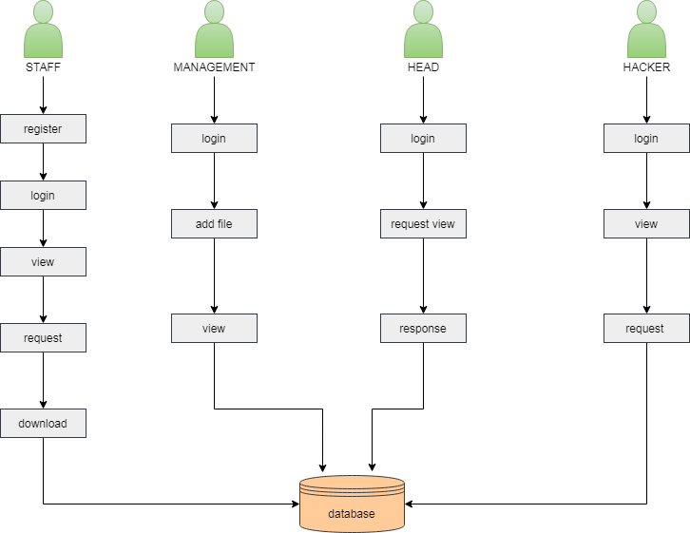
ARCHITECTURE DIAGRAM:

Slide 17

DATA FLOW DIAGRAM:
LEVEL 1:

Slide 18
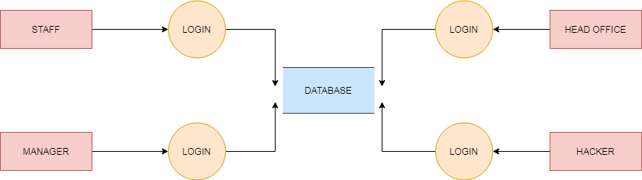
LEVEL 2:

Slide 19
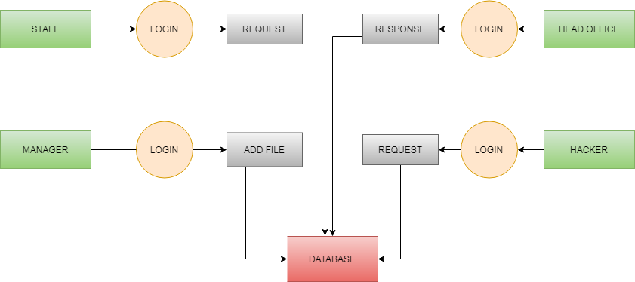
LEVEL 3:

Slide 20
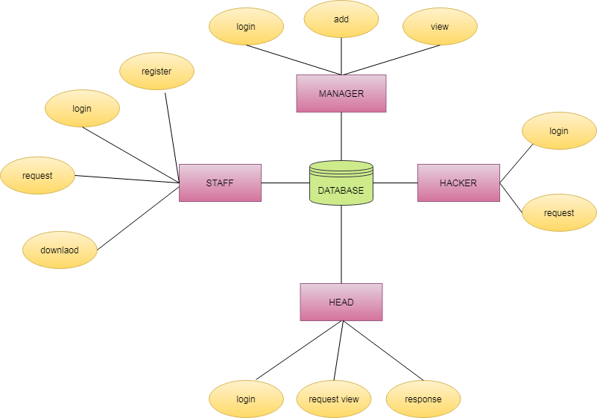
E-R DIAGRAM:

Slide 21
MODULES:
LOGIN
ADD FILE
VIEW
REQUEST
RESPONSE
DOWNLOAD

Slide 22
MODULE DIAGRAM:
LOGIN:
STAFF
LOGIN
MAINPAGE
ADD FILE:
MANAGER
ADD FILE
DATABASE

Slide 23
VIEW:
STAFF
VIEW
DATABASE
REQUEST:
STAFF
REQUEST
DATABASE

Slide 24
RESPONSE:
HEAD
RESPONSE
DATABASE
DOWNLOAD:
STAFF
KEYENTER
DOWNLOAD

Slide 25
MODULE EXPLANATION:
LOGIN:
This module gives the way to enter into main page after login with valid input such as username or email id and password.
ADD FILE:
This module is help us to The manager add the file or document to the database. To view the staffs.
VIEW:
This module to help us the staff view the file. But the staff cannot be open the file until the Head office accept the file. After response the head office the file can view by the staff with the help of secret key.
REQUEST:
This module to help to staff request the file to head office and the head office accept the request. And third party or hacker also request the file.
RESPONSE:
This module to help to staff requested file to head office accept the request. And the hacker or third party also request the file. But the hacker request doesn’t Show the ip address of the hacker. Then the head office will identify the requested person is hacker or valid user.
DOWNLOAD:
This module is help to staff download the file after head office approve the request.

Slide 26
DESIGN DIAGRAM:
GENERAL
Design Engineering deals with the various UML [Unified Modeling language] diagrams for the implementation of project. Design is a meaningful engineering representation of a thing that is to be built. Software design is a process through which the requirements are translated into representation of the software. Design is the place where quality is rendered in software engineering. Design is the means to accurately translate customer requirements into finished product.

Slide 27
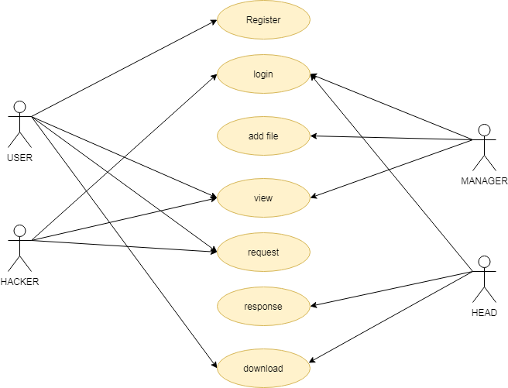
USE CASE:

Slide 28
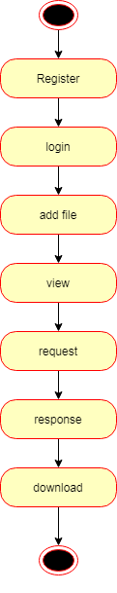
STATE DIAGRAM:

Slide 29
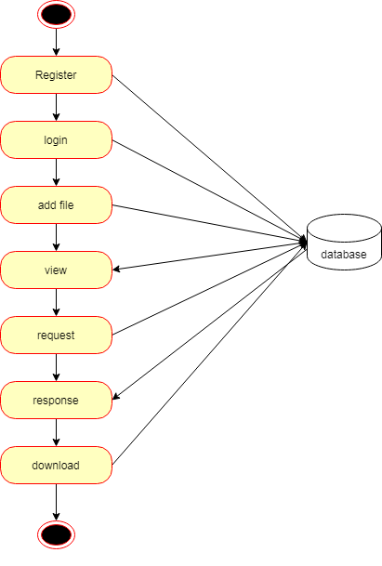
ACTIVITY DIAGRAM:

Slide 30
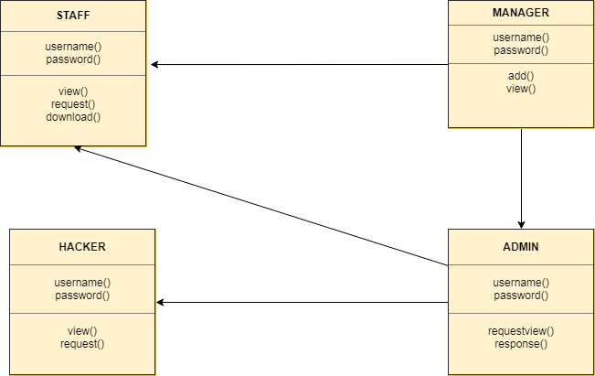
CLASS DIAGRAM:

Slide 31
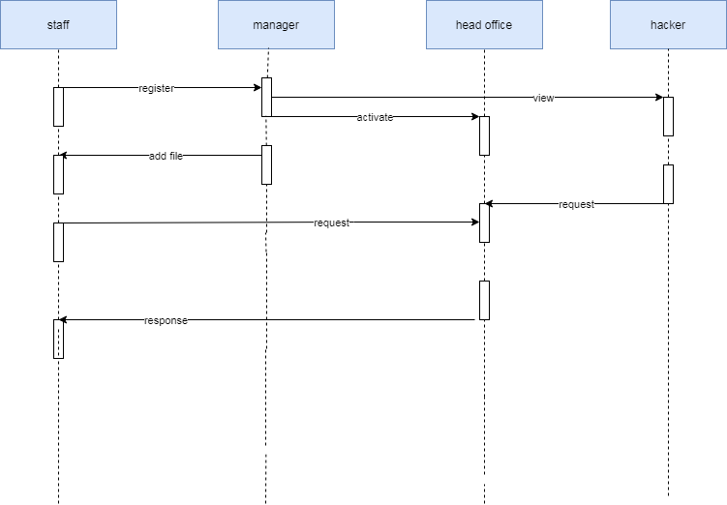
SEQUENCE DIAGRAMM:

Slide 32
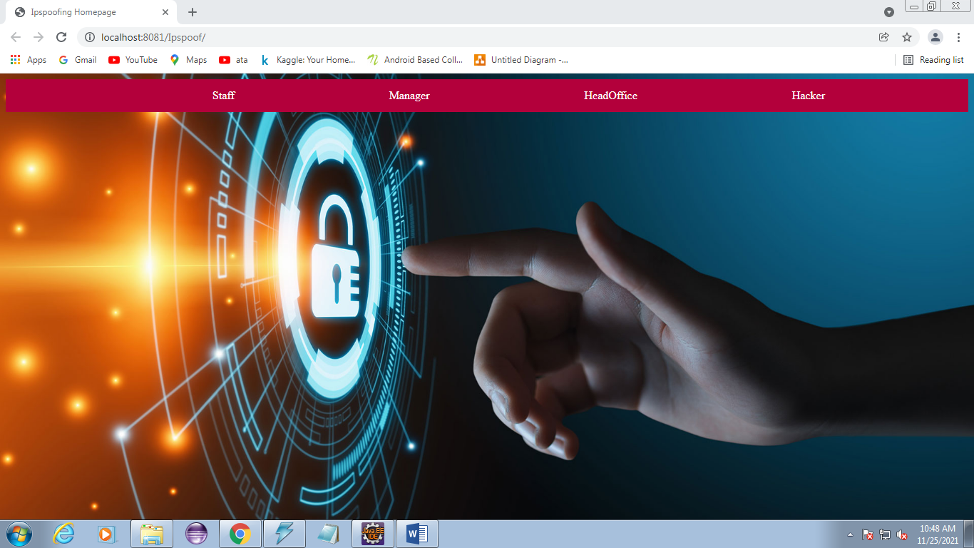
SCREEN SHOTS:

Slide 33
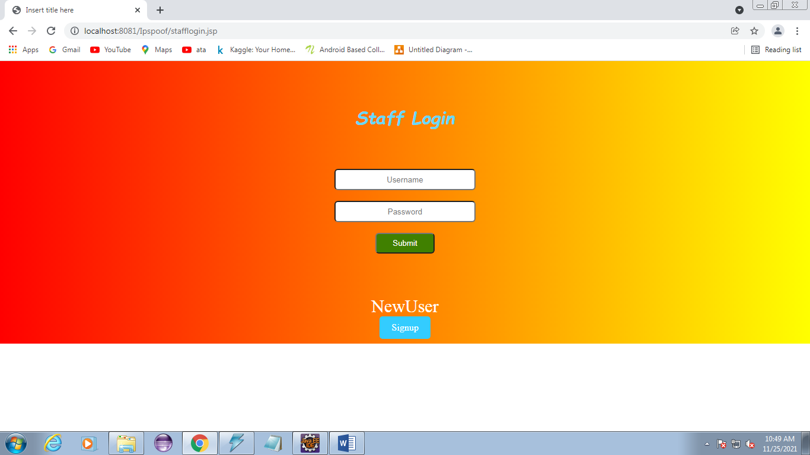

Slide 34
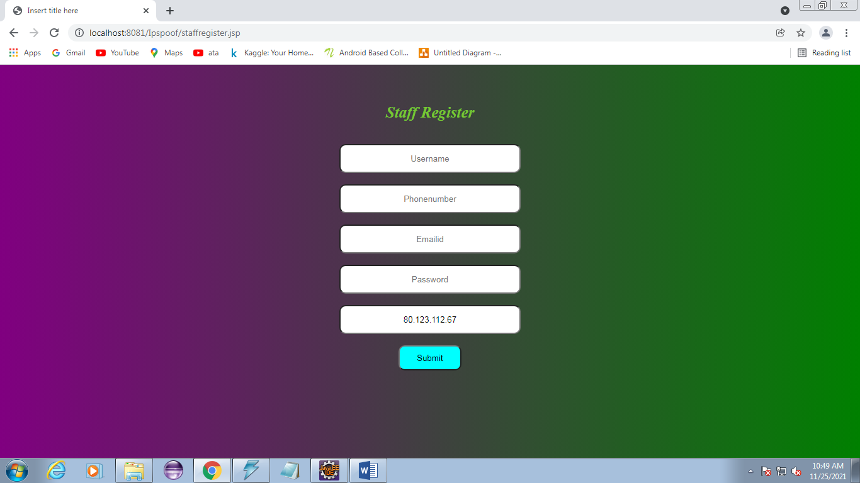

Slide 35
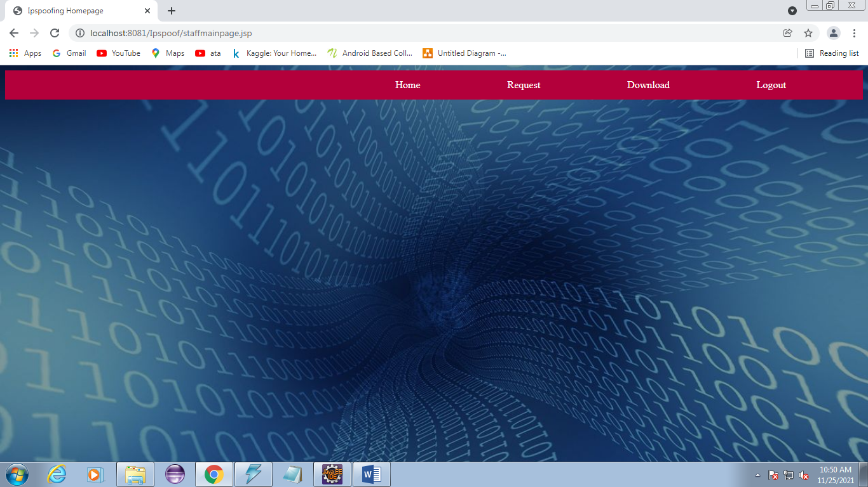

Slide 36
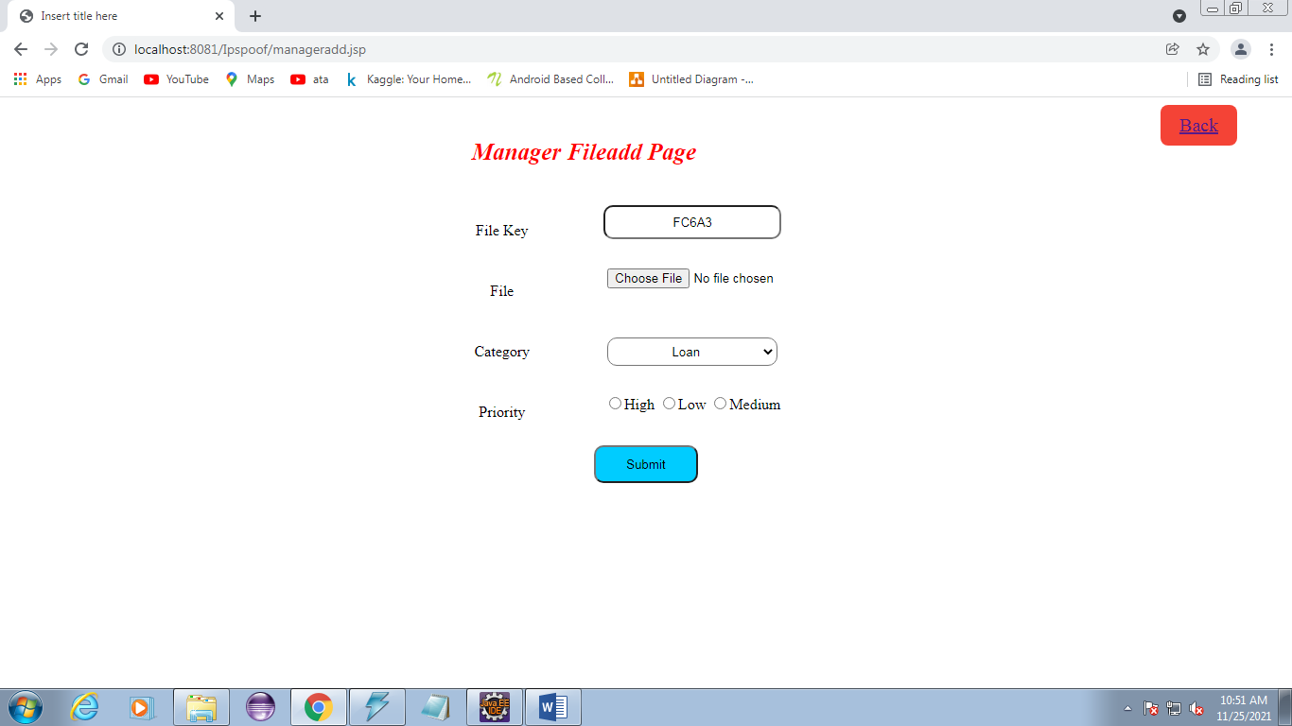

Slide 37
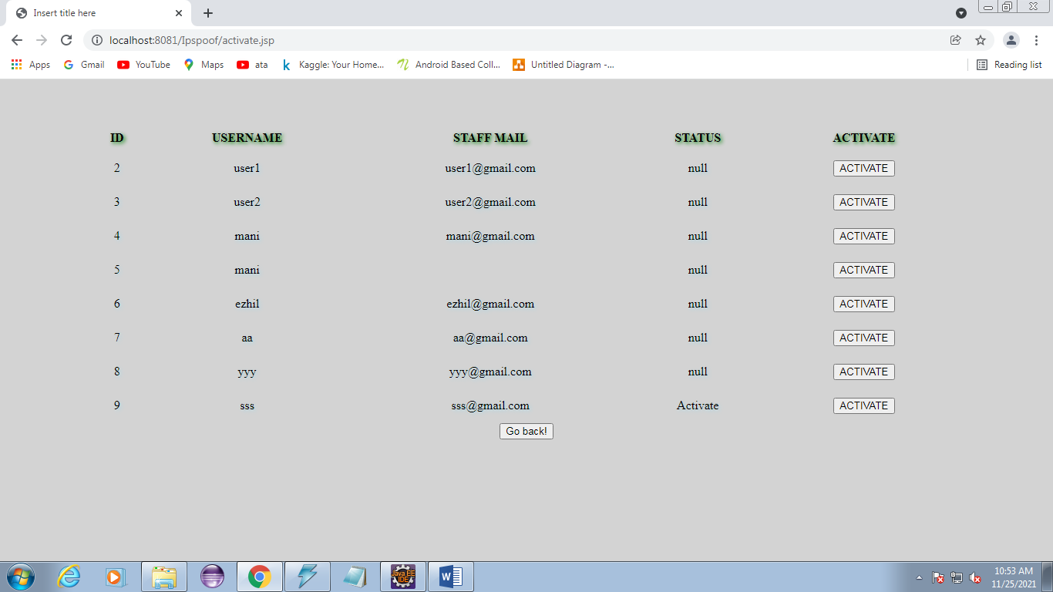

Slide 38
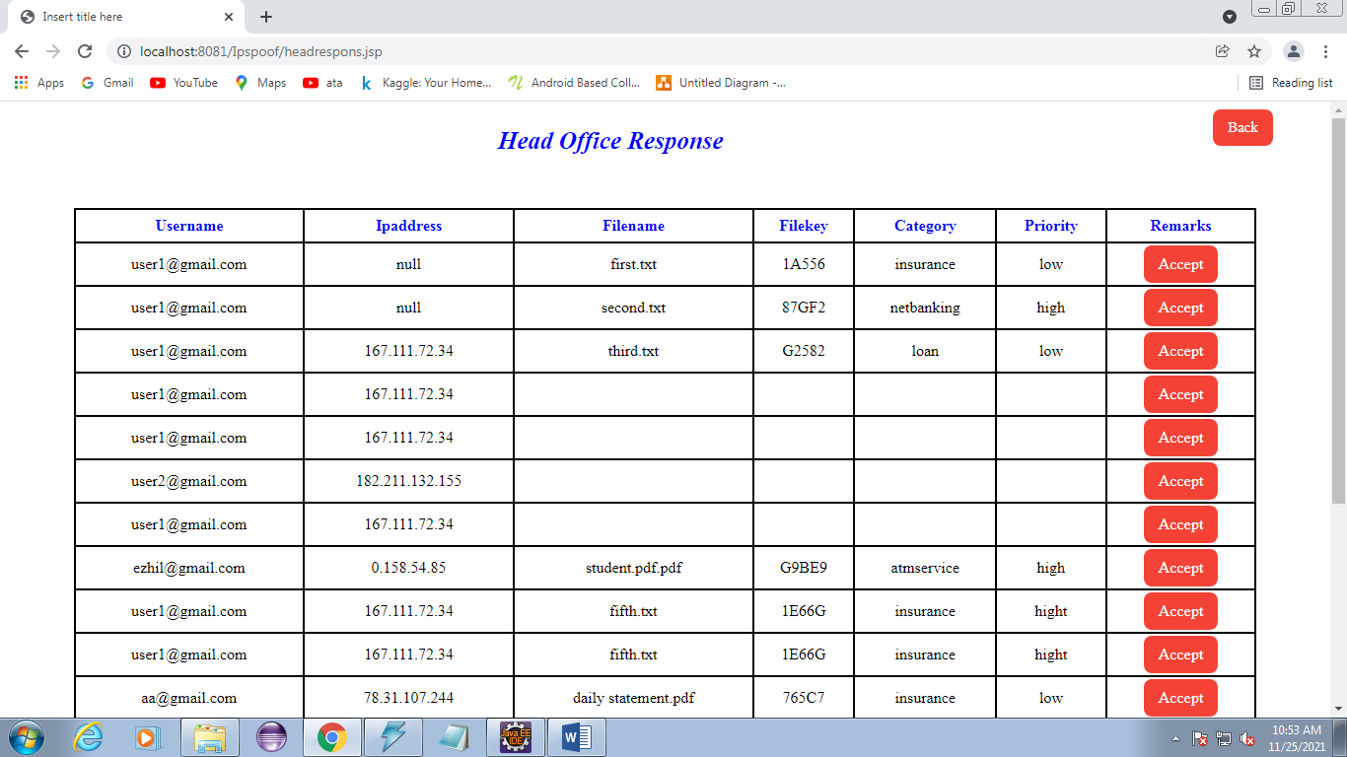

Slide 39
CONCLUSION:
We imagine two examination fronts for future work. One is to extend our methods to lessen bunch estimates considerably more, e.g., planning new calculations for picking focuses for harming, and involving BGP people group for controlling commodity strategies (and impact steering choices) on remote organizations.
Another is to grow the framework to permit distinguishing proof of wellsprings of parodied traffic during DDoS assaults, e.g., by (I) mutually enhancing for group size and traffic volume, giving higher utility to diminishing the size of bunches deduced to send more ridiculed traffic; and (ii) further developing existing catchment expectation strategies [18] to permit age of declaration designs without earlier information and lessening the requirement for estimating catchments ahead of time.
One of a Best Encryption Algorithm is used to encrypt and decrypt the file and security enhancement to provide security and protect suspicious filemigration and better storage is applied (Aws Cloud-RDS)

Slide 40
FUTURE ENHANCEMENTS:
1. Implementing a true unknown information base framework.
2. Improving the effectiveness of conventions, as far as number of messages traded and concerning their sizes, too.
3. Implement using AES algorithm.
4. Manage will find the legitimate client or programmer for secure the information record.

Slide 41
REFERENCE:
[1] J. Czyz, M. Kallitsis, M. Gharaibeh, C. Papadopoulos, M. Bailey, and M. Karir, “Taming the 800 Pound Gorilla: The Rise and Decline of NTP DDoS Attacks,” in Proc. ACM IMC, 2014.
[2] M. Prince, “Technical Details Behind a 400Gbps NTP Amplification DDoS Attack,” Feb 2014. [Online]. Available: https://blog.cloudflare. com/technical-details-behind-a-400gbps-ntp-amplification-ddos-attack
[3] K. York, “Dyn Statement on 10/21/2016 DDoS Attack,” 2016, http://dyn.com/blog/dyn-statement-on-10212016-ddos-attack/.
[4] L. H. Newman, “Github Survived the Biggest DDoS Attack ever Recorded,” Wired, March 2018.
[5] V. Paxson, “An Analysis of Using Reflectors for Distributed Denial-ofservice Attacks,” SIGCOMM Comput. Commun. Rev., vol. 31, no. 3, pp. 38–47, 2001.

Slide 42
THANK YOU

